Slide 1


BAGYOBAI, Typhoon Predictor
“Turn on your sounds for better experience”
Swayside squad – borce, luzande, quemada

Slide 2
agenda
Problem Background
SDG Relevance
ML Model Explanation
KRR Rules Explanation
System Demonstration
Results
Team Contributions

Slide 3
Problem background
1. Loss of Life and Displacement
2. Economic Damages
3. Food Security Issues
4. Public Health Crisis
5. Environmental Degradation
The Philippines is one of the countries most affected by tropical cyclones (typhoons) due to its geographical location in the Western Pacific Ocean. These typhoons bring devastating impacts, including:

Slide 4
Sdg relevance
SDG 1: No Poverty
SDG 3: Good Health and Well-being
SDG 9: Industry, Innovation and Infrastructure
SDG 11: Sustainable Cities and Communities
SDG 13: Climate Action
BagyoBAI, enhancing typhoon forecasting capabilities, directly and indirectly contributes to several United Nations Sustainable Development Goals (SDG), particularly focused on poverty, health, infrastructure, climate action, and resilient communities.

Slide 5
ML Model explanation
1. Ridge Regression
Concept – A linear model that identifies straightforward relationships.
2. Random Forest Regressor
Concept – An ensemble of many decision trees.
In BagyoBAI, we employ two primary machine learning models for time series forecasting of typhoon counts: Ridge Regression and Random Forest Regressor. These models were chosen for their effectiveness in handling different types of data relationships and their interpretability (to a certain extent).

Slide 6
Krr rules explanation
Enhance Interpretability
Improve Robustness
Support Hybrid Intelligence
While BagyoBAI's core forecasting relies on machine learning models, the concept of Knowledge Representation and Reasoning (KRR) offers a powerful complementary approach. KRR is about structuring information (knowledge) in a way that allows a system to draw conclusions, make decisions, or understand phenomena based on logical rules and relationships. For BagyoBAI, KRR would involve explicitly codifying meteorological expertise and established scientific principles into a computable format.

Slide 7
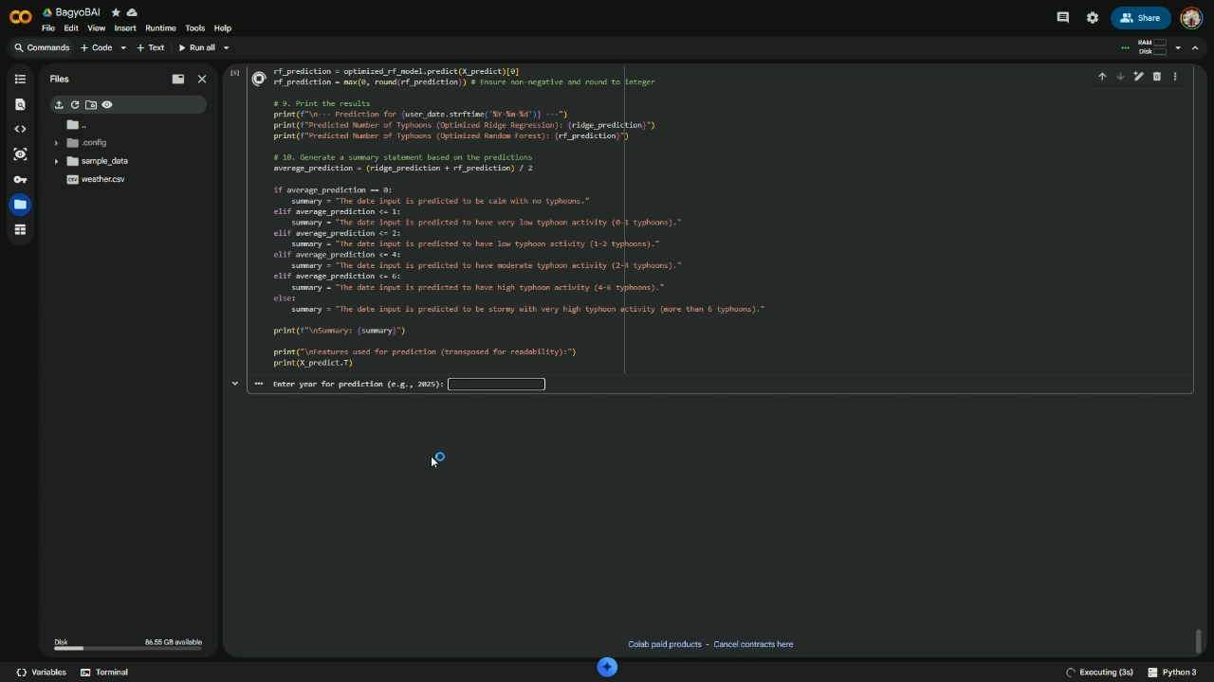
System Demonstration and results

Slide 8



Team contribution
Borce, Ron Ken S.
Assistant Manager & Developer, Documentation, Presenter
Luzande, Justin Angelo A.
Team Leader, Project Manager & System Developer, Demonstrator, Presenter
Quemada, John Alvin Y.
Assistant & Team Support

Slide 9
Thank you for listening!
Swayside squad

